Slide 1
Bios 520-Clinical Trials-Sample size
February 23, 2023

Slide 2
Outline
Lecture
Elements of Sample size
Continuous outcome
Dichotomous outcome
Time to event outcome (next week)

Slide 3
Fundamental point
Sample size calculation plays an important role in clinical research, particularly in clinical trials. The size of the study should be considered early in the planning phase.
The purpose is to select a sample size such that the selected sample size will achieve a desired power for correctly detecting a prespecified clinically meaningful difference for a given level of significance.

Slide 4
Statistical significance but not clinically meaningful
New Cholesterol lowering agent.
1,000 subjects on strict diet
Total cholesterol decreased by 1 ng-percent
(p < 0.0001)
Statistically significant but clinically not meaningful

Slide 5
Clinically significant but not statistically significant
With new blood pressure treatment (n=4) | Without treatment (n=4)
140 | 150
123 | 132
130 | 142
155 | 170
Average: 137 | Average: 148
P=.32

Slide 6
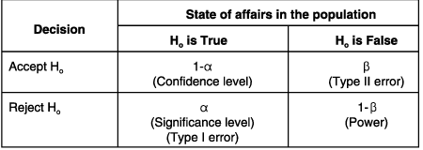
Type I and Type II errors
Study trial
True positive
False negative
Drug ineffective
False positive
True Negative
Drug effective

Slide 7

Type I, Type II errors & power
It is possible to reject the null hypothesis when it is actually true. Obviously, you do not want this to happen.
That is, the maximum probability of rejecting the null hypothesis when it is true that the researcher is willing to risk is called the significance level of the test, denoted by $α$
$α$=probability of rejecting a true null hypothesis
α=P(make a Type I error) =P(reject H₀ when H₀ is true) | β=P(make a Type II error) =P(not reject H₀ when H₁ is true)

Slide 8
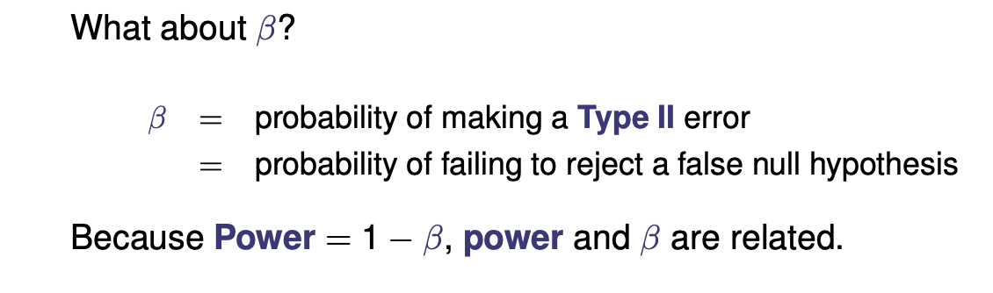
Type II and Beta

Slide 9
Type I, Type II errors & power
α=P(make a Type I error) =P(reject H₀ when H₀ is true) | β=P(make a Type II error) =P(not reject H₀ when H₁ is true)
The probability of making a Type II error depends on:
sample size n
significance level α
the true value of the parameter μ

Slide 10

Self check!
Power is the probability of:
rejecting a true null hypothesis
failing to reject a true null hypothesis
rejecting a false null hypothesis
failing to reject a false null hypothesis
Do you want power to be close to 0 or 1? What about $β$?

Slide 11
Type I, Type II errors & power
Ideally, a test of hypothesis should reject H0 when it is false. The probability that the test detects a false H0 is called the power of the test.
Power = P(reject H0 when H1 is true)
=1-P(making a type II error)
= 1 − β
Often, the null hypothesis is that there is no effect (or no association). Power can then be thought of as the probability of detecting an effect (or association), given that the effect (or association) actually exists.
Because power is a probability, it lies between 0 and 1, inclusive. If the power is near 0, the statistical test is not very good at detecting a false null hypothesis; if the power is near 1, the test is extremely good at detecting a false null hypothesis.

Slide 12
Power
Power = probability of rejecting a false null hypothesis OR the probability that it will result in statistical significance.
Power and sample size calculations are performed in the design phase of a study.
We want a test to be sufficiently powered to detect a meaningful difference, but an increase in power means an increase in the cost of conducting the study. Not enrolling enough patients may lead to an underpowered test, where a significant difference is not detected. Enrolling too many patients would lead to an overpowered test, which wastes time and money.
Since statistical significance is the desired outcome of a study, planning to achieve high power is of prime importance to the researcher.
Can you blame power at the end of the study?

Slide 13
Sample size calculations
Generally, calculation of the sample size depends on:
the study design
the outcome variable: continuous, count, dichotomous, time-to-event
the exposure variable: continuous, categorical
the statistical test used

Slide 14
Dichotomous outcomes

Slide 15
Dichotomous outcomes
For dichotomous outcomes, you often base your analysis on proportions.
You will look at both the one-sample case and the two-samples case (two sample will be done first).

Slide 16
Sample Size Exercise
How many do I need?
Next question, what’s the question?
Reason is that sample size depends on the outcome being measured, and the method of analysis to be used

Slide 17
Example: 2 proportions: How many subjects?
Compare new treatment (T) with a control (C)
Previous data suggests Control Failure Rate (P_{c}) ~ 40%
Investigator believes treatment can reduce P_{c} by 25%
i.e. P_{T} = .30, P_{C} = .40
N = number of subjects/group?

Slide 18
Typical Design Assumptions (1)
1. α = .05, .025, .01
2. Power = .80, .90
Should be at least .80 for design
3. Δ = smallest difference hope to detect
e.g. Δ = P_{C} - P_{T}
= .40 - .30
= .10 25% reduction!

Slide 19
Typical Design Assumptions (2)
Significance Level
Two Sided
Power

Slide 20
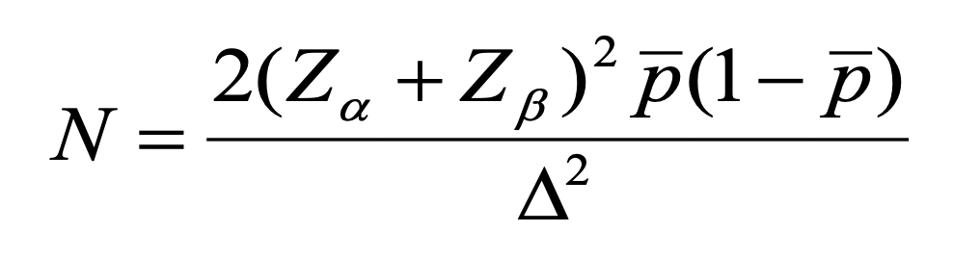
Sample size formula-2 proportions
Simpler case
Z_{α} = constant associated with α
P {|Z|> Z_{α} } = α two sided!
(e.g. α = .05, Z_{α} =1.96)
Z_{β =} constant associated with 1 – β
Solve for Z_{β} (⇒ 1- β) or Δ
P {Z< Z_{β}} = 1- β
(e.g. 1- β = .90, Z_{β} =1.282)

Slide 21
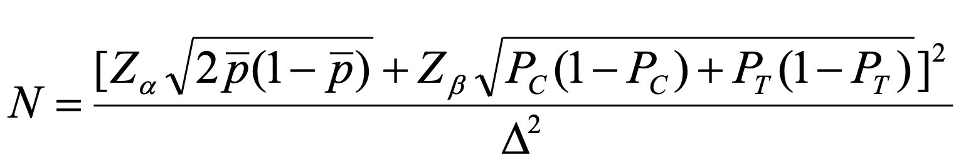
Sample Size Formula (2) Two Proportions
Z_{α} = constant associated with α
P {|Z|> Z_{α} } = α two sided!
(e.g. α = .05, Z_{α} =1.96)
Z_{β =} constant associated with 1 - β
P {Z< Z_{β}} = 1- β
(e.g. 1- β = .90, Z_{β} =1.282)

Slide 22
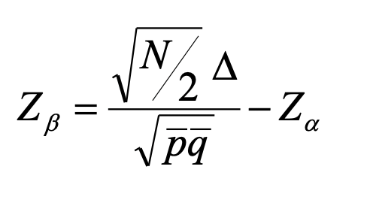
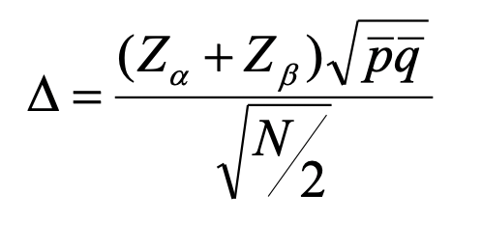
Sample size formula
Power.
Solve for Z_{β} ⇒ 1- β
Difference detected
Solve for Δ

Slide 23
Simple Example (1)
H₀: P_{C} = P_{T}
H_{A}: P_{C} = .40, P_{T} = .30
Δ = .40 - .30 = .10
Assume
α = .05 Z_{α} = 1.96 (Two sided)
1 - β = .90 Z_{β} = 1.282
p = (.40 + .30 )/2 = .35

Slide 24
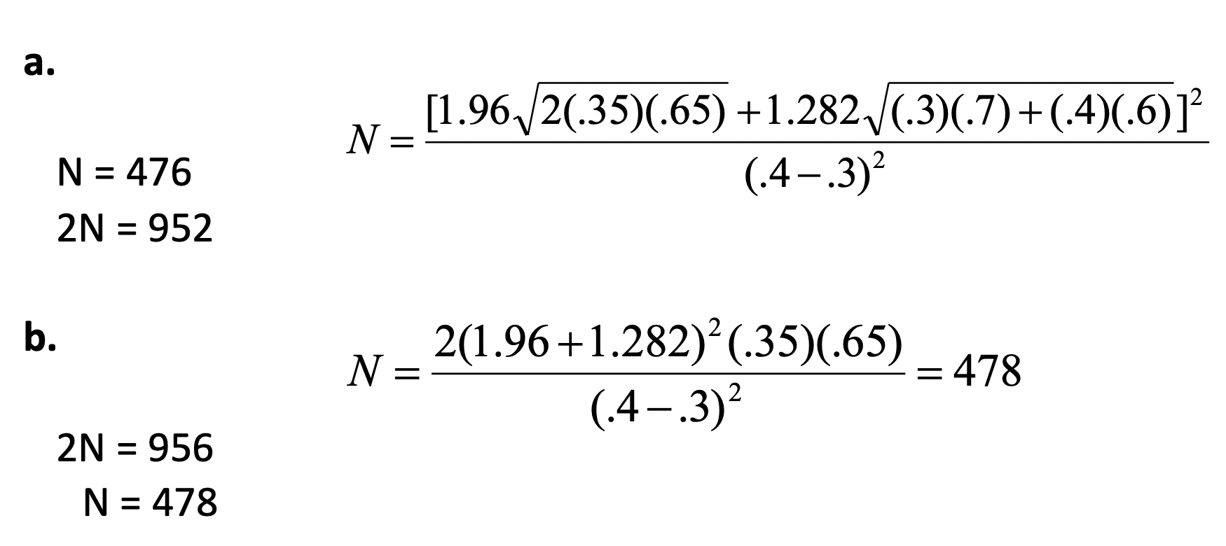
Results from 2 methods
R code: power.prop.test(p1 = .30, p2 = .40, power = .90)
Web calculator: https://www.stat.ubc.ca/~rollin/stats/ssize/b2.html

Slide 25
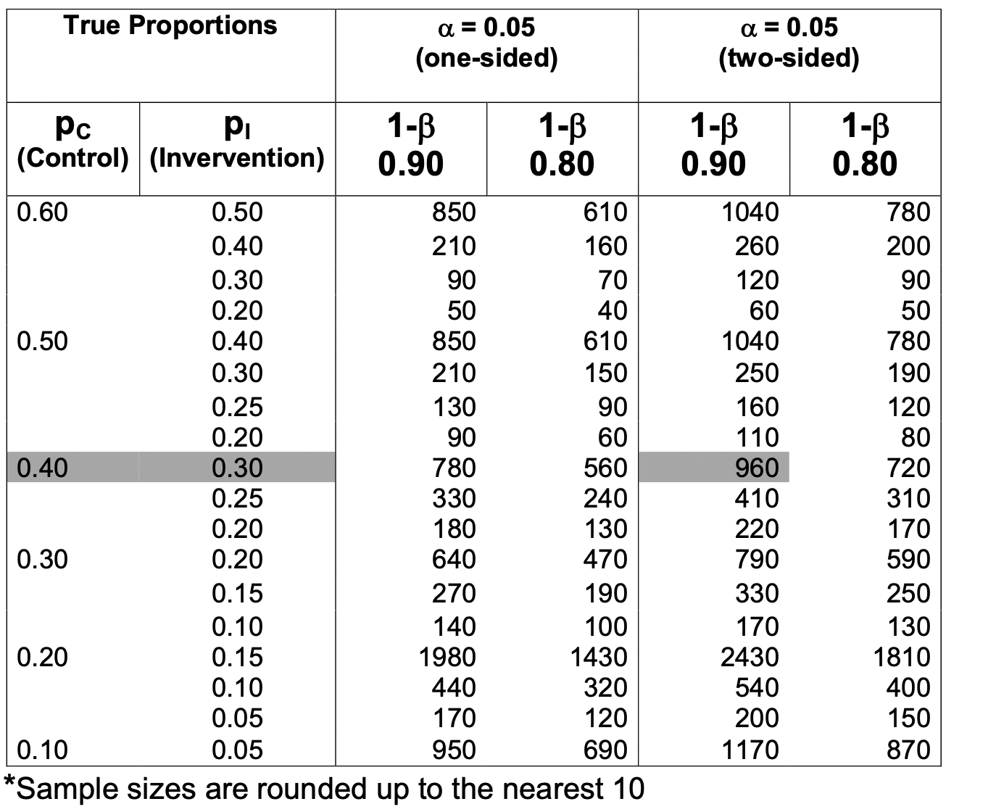
Approximate* Total Sample Size for Comparing Various Proportions in Two Groups with Significance Level (α) of 0.05 and Power (1-β) of 0.80 and 0.90

Slide 26
Another example: Two proportions
A clinical trial was designed to test effectiveness of a drug in reducing mortality in the first year after a myocardial infarction.
Assume current mortality rate during the first year is 16% and they hope to detect a 30% decrease in this rate.
New rate is 70% of 16% which is 11.2%.
Assuming a two-sided test with a significance level of 0.05, what sample size will be necessary to achieve 90% power?

Slide 27
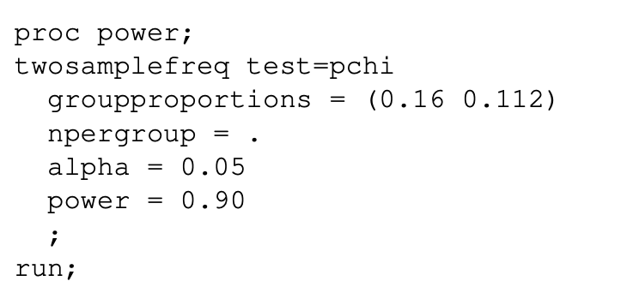
SAS and R code

Slide 28
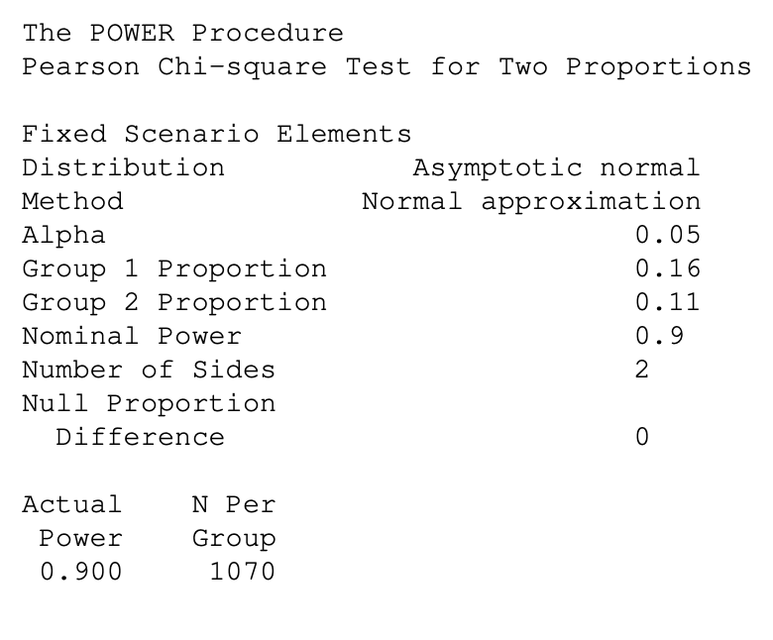
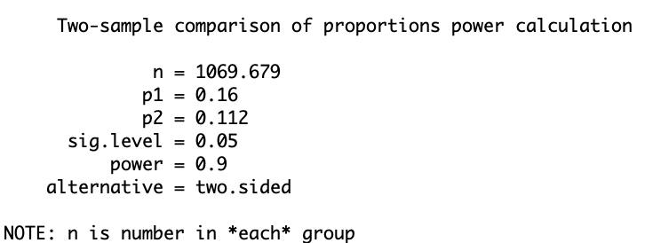
SAS output
Group sample sizes of 1070 and 1070 achieve 90% power to detect a difference of 0.048 between the null hypothesis that both group proportions are 0.16 and the alternative hypothesis that the proportion in group 2 is 0.112 using a two-sided chi-square test with a significance level of 0.05.

Slide 29
Did you get that to work?
SAS? R? web?

Slide 30
One sample proportion
Suppose 50% of patients with a certain type of cancer survive five-years. A new treatment will be adopted if it can increase this percentage to 60%. What power will be achieved if a historically controlled trial has sample sizes of 50, 100, 200, or 300? Try significance levels of 0.01 and 0.05.
Note: ‘Historically controlled’ means that no control group is formed. Instead, the rates reported from previous studies or that are known to exist in the general population are used. Because of the many advantages that occur when an actual control group is used, historically controlled trials should only be used when a control group is either impossible or unethical.

Slide 31
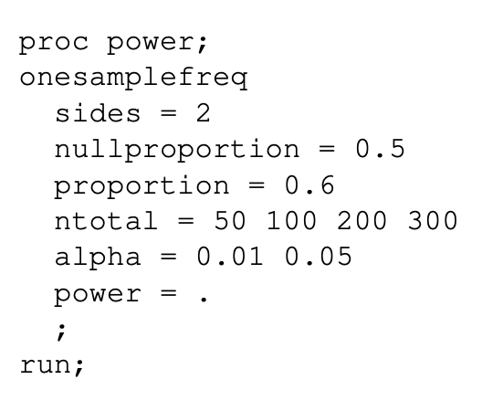
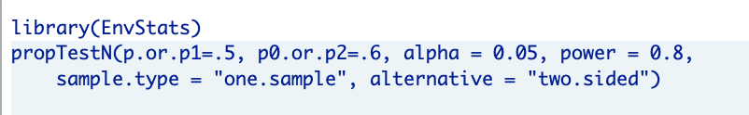
Code

Slide 32
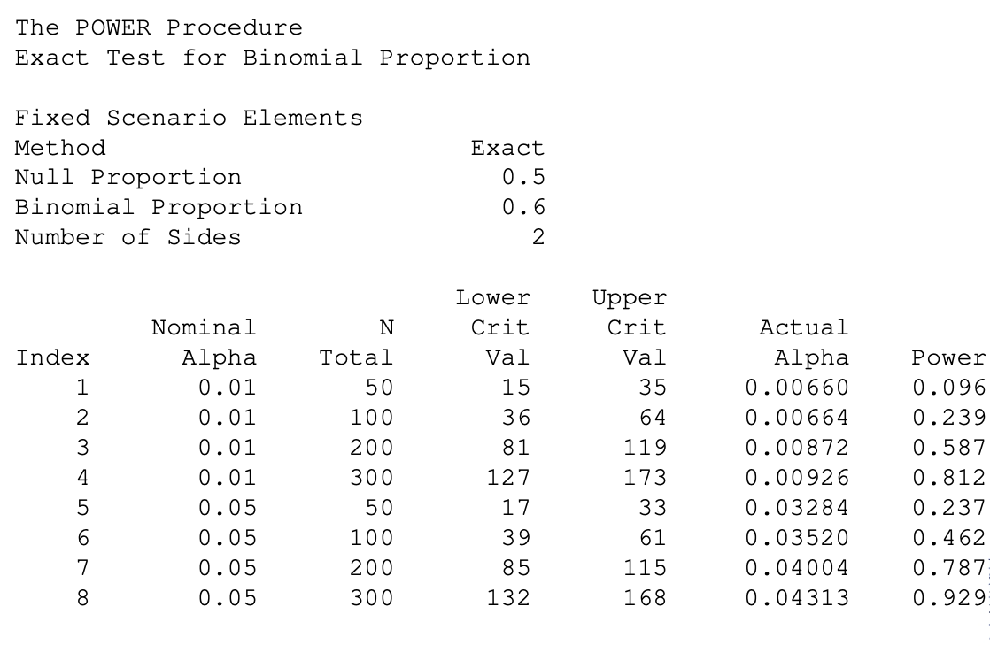
SAS output

Slide 33
Lastly, on One sample proportion
Using SAS, you see that 80% power is achieved at α = 0.05 with n = 200 and at α = 0.01 with n = 300.
Continuing with the example, suppose you want to study the impact of p1 on the sample size. Using a significance level of 0.05 and 90% power, find the sample size when p1 is 0.55, 0.6, 0.65, 0.70, 0.75, and 0.80. Assume that a two-tailed hypothesis test will be used.
The SAS output shows that a sample size of only 28 is needed to detect the difference between 0.5 and 0.8, but a sample size of 1055 is needed to detect a difference between 0.50 and 0.55.
Note: Add the line test=z method=normal when solving for the sample size.
Note: In R, whatever parameter is not specified (ie. power, sample size, effect size, etc) is what will be calculated

Slide 34
Continuous outcomes

Slide 35
Comparison of Means
Some outcome variables are continuous
Blood Pressure
Serum Chemistry
Pulmonary Function
Hypothesis tested by comparison of mean values between groups, or comparison of mean changes

Slide 36
Effect size
The effect size is the size of the change in the parameter of interest that can be detected by the study.
Selecting an appropriate effect size is often difficult because it is very subjective. The question is: what size change in the parameter would be of clinical interest? The answer to this question is the effect size that is useful.
Often, the effect size is stated as a percentage change rather than an absolute change or a standardized difference.
Effect size definition AND interpretation depends on the statistical test

Slide 37
One sample t test
In studying deaths from SIDS (Sudden Infant Death Syndrome), one hypothesis put forward is that infants dying of SIDS weigh less than normal at birth.
Suppose the average birth weight of infants is 3300 grams with a standard deviation of 663 grams.
Using α = 0.05 and β = 0.20, 0.10, how large a sample of SIDS infants will be needed to detect a drop in average weight of 25%? Of 10%? Of 5%?
(Note that applying these percentages to the average weight of 3300 yields 2475, 2970, and 3135.)

Slide 38
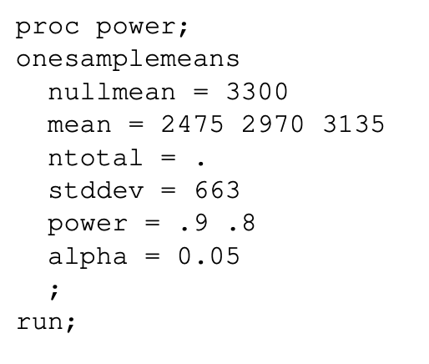
SAS and R code

Slide 39
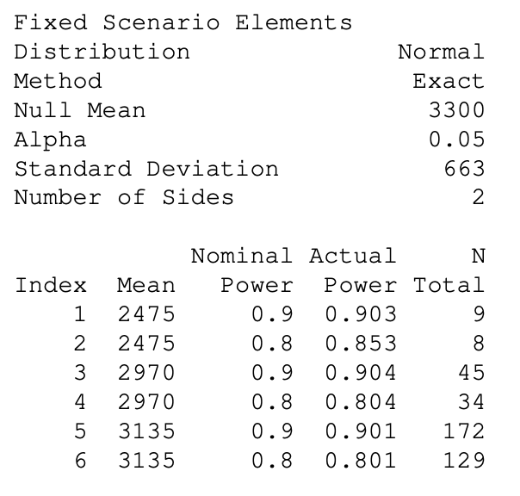
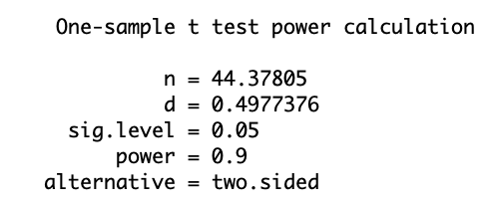
Output
A sample size of 45 infants achieves 90% power to detect a difference of 330 grams between the null hypothesis mean of 3300 grams and the alternative hypothesis mean of 2970 grams with an estimated standard deviation of 663 grams and with a significance level of 0.05 using a two-sided one-sample t -test.

Slide 40
Summary of output: One sample mean
Although a one-sided hypothesis is being considered, sample size estimates will assume a two-sided alternative to keep the research design in line with other studies.
The SAS output shows the values of each of the parameters, one scenario per row. Since there were 3 values of the new mean and 2 values of power, there are a total of 6 rows in the report.
Note that even though you set β = 0.1, 0.2, these are not the β that were achieved. This happens because n can only take on integer values.

Slide 41
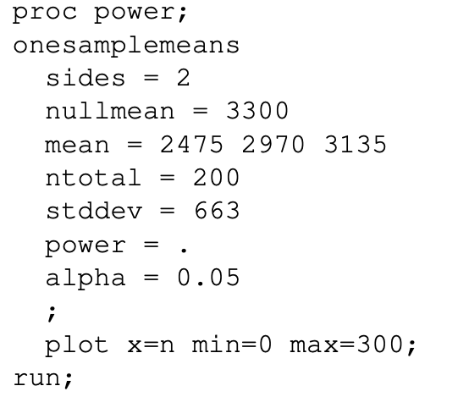
One sample mean
In some instances, it may be desired to find power given particular sample size. For instance, the maximum possible sample size may be restricted by budget or ability to recruit.
For a fixed effect size, power always increases with increasing sample size. Conversely, an increase in power requires a larger sample size.

Slide 42
Dependent means
Suppose researchers want to study the impact of an exercise program on weight loss.
To do so, they randomly select n individuals, weigh them, put them through the exercise program that will last three months, and weigh them again.
The variable of interest is not their actual weight, but how much their weight changed. That is, the difference in their weights will be analyzed.

Slide 43
Dependent means
In this design, the data are analyzed using a one-sample t-test on the differences between the paired observations. The hypotheses to be tested are
H0: the average difference is zero (null hypothesis)
H1: the average difference is some nonzero value (alternative hypothesis)
Previous studies of this type have had standard deviations in the range of 10 to 15 pounds. The researcher wants to detect a difference of 5 pounds or more. α values of 0.01 and 0.05 will be tried. β is set to 0.20 so that the power is 80%. How large of a sample must the researchers take?

Slide 44
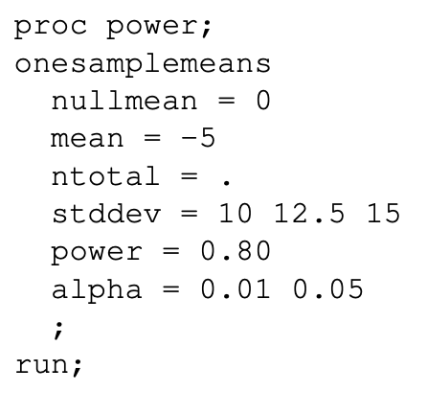
SAS and R code
It is important to note that in this example, stddev refers to the standard deviation of the change in weight, not the standard deviation of the weights at baseline or the standard deviation of the weights at three months.

Slide 45
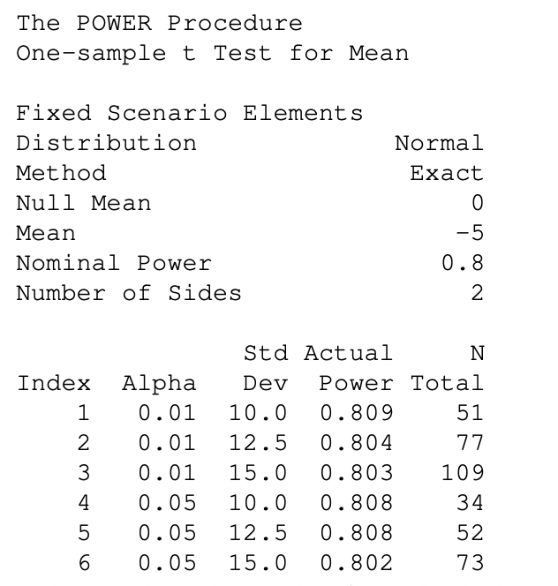
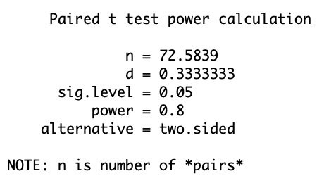
Output
Assuming a standard deviation of 15 lbs, a sample size of 73 individuals achieves 80% power to detect a difference of -5 lbs between the null hypothesis mean difference of 0 lbs and the actual mean difference of 5 lbs at the 0.05 significance level using a two-sided paired t-test.
Note that the unit of analysis is a pair of individuals. Hence, N Total here refers to the number of pairs, not the number of individuals.

Slide 46
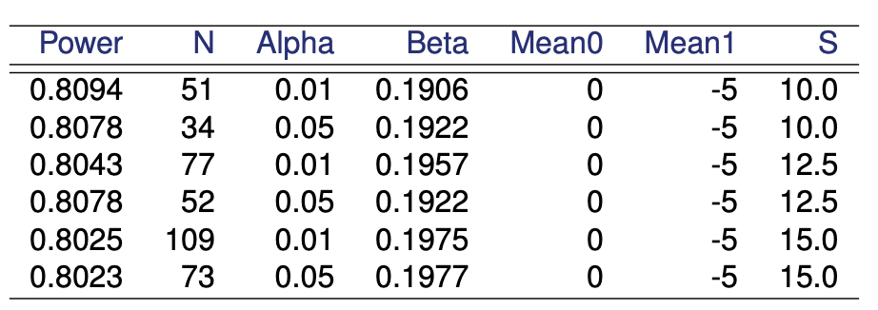
Dependent means
Note that depending on your choice of assumptions, the sample size ranges from 34 to 109. Hence, you have to make a careful determination of which standard deviation, significance level and power should be used.

Slide 47
Dependent means
The previous SAS code assumes we know the standard deviation of the change in weights from baseline to three months.
Suppose we do not know the standard deviation of weight change but instead have the standard deviation of the weights at baseline and the standard deviation of the weights at three months. We can use the code (next slide) instead
In the code, the standard deviation of the change in weights from baseline to three months is calculated using the formula

Slide 48
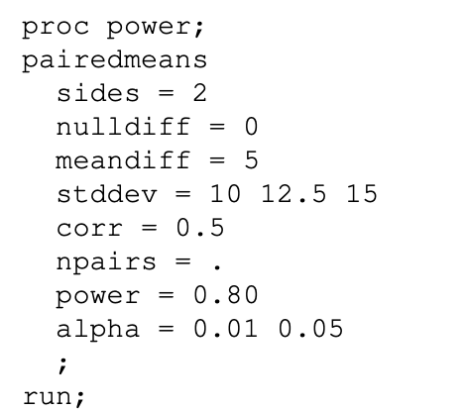
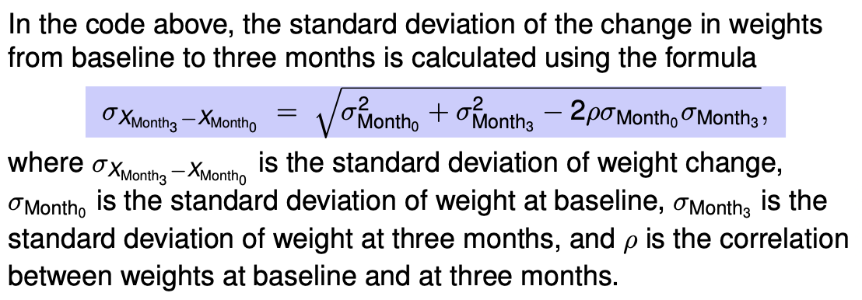
Dependent means

Slide 49
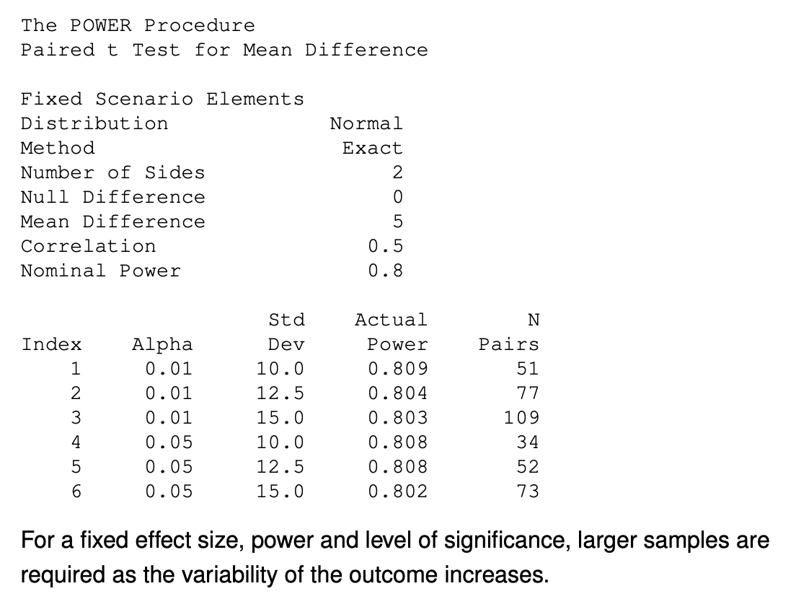
SAS output

Slide 50
Quantitative outcomes: Two sample means
So far, one sample mean and dependent mean
How does this scenario differ?
μ₁ = mean expected on treatment 1
μ₂ = mean expected on treatment 2
α, b defined as above
σ² = variance of this outcome in the population

Slide 51
QUANTITATIVE OUTCOMES MEANS BETWEEN GROUPS

Slide 52
QUANTITATIVE OUTCOMES MEANS BETWEEN GROUPS
Symmetries
Function of (μ₂-μ₁)²
Directly proportional to σ²

Slide 53
EXAMPLE
In a trial to examine maternal vitamin D supplementation in pregnancy to prevent neonatal hypocalcemia, women are to be randomized to receive a vitamin D supplement or a placebo, then serum calcium will be measured in their infants at 1 week of age.

Slide 54
Example
In this case we expect m1 = 9.0 mg/100ml for serum calcium in the placebo group, and we want to detect m2 - 9.5 mg/100ml in the treated group. We set a = 0.05, 1-b = 0.95. In this population we know that s=1.8 mg/100ml.
What do you calculate?

Slide 55
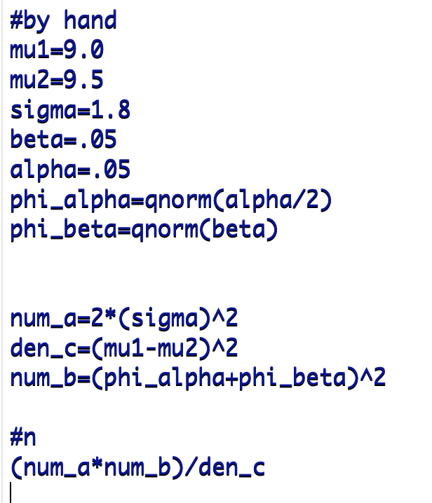
Manual calculation
In R using formula:

Slide 56
Sample size
Using the formula above gives n = 337 / group.
https://www.stat.ubc.ca/~rollin/stats/ssize/n2.html

Slide 57
EXAMPLE
Common question: How to define μ₁, μ₂, σ?
Answer: Clinical judgement.

Slide 58
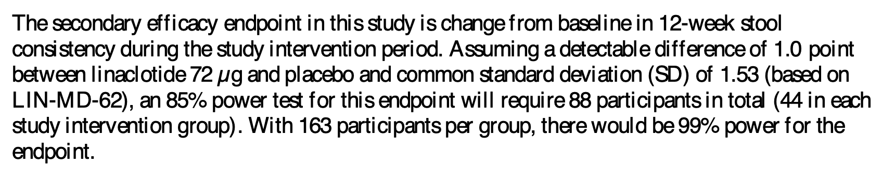
From a protocol
A Phase 3, International, Multicenter, Randomized, Double-blind, Placebo-controlled, Parallel-group Efficacy and Safety Trial of Linaclotide Administered Orally for 12 Weeks to Patients With Irritable Bowel Syndrome With Constipation

Slide 59
Can you duplicate these results?
Via web? R?

Slide 60
Bringing it all together…Example
Suppose a new drug is to be tested for the purpose of pain relief among patients with osteoarthritis (OA).
The measure of pain relief will be the percent change in level of pain as reported by the patient after taking the medication for one month.
Fifty OA patients will participate in the study. What are the hypotheses to be tested?
What do the Type I error, Type II error, and power mean in this context?
Notes:
Ref Bernard Rosner, Fundamentals of Biostatistics (2006, p. 229).

Slide 61
Example
The hypotheses to be tested are:
H0: the mean change in level of pain over a one-month period is zero (null hypothesis)
H1: the mean change in level of pain is different from zero (alternative hypothesis)
What does Type I error mean in this situation?

Slide 62
Example
The hypotheses to be tested are
H0: the mean change in level of pain over a one-month period is zero (null hypothesis)
H1: the mean change in level of pain is different from zero (alternative hypothesis)
A Type I error is the probability of deciding that the drug is an effective pain reliever based on data from 50 patients, given that the true state of nature is that the drug has no effect on pain relief. The true state of nature here means the effect of the drug when tested on the entire population of patients.
What does Type II error mean in this situation?

Slide 63
Example
The hypotheses to be tested are
H0: the mean change in level of pain over a one-month period is zero (null hypothesis)
H1: the mean change in level of pain is different from zero (alternative hypothesis)
A Type II error is the probability of deciding that the drug has no effect on pain relief based on data from 50 patients given that the true state of nature is that the drug affects pain relief.
What does power mean in this situation?

Slide 64
Example
The hypotheses to be tested are
H0: the mean change in level of pain over a one-month period is zero (null hypothesis)
H1: the mean change in level of pain is different from zero (alternative hypothesis)
The power of the test is the probability of deciding that the drug is effective as a pain reliever based on data from 50 patients when the true state of nature is that it is effective.

Slide 65

P-value and $α$
The term α-value is often used interchangeably with the term p-value.
Although these two terms are closely related, there is an important distinction between them.
While the value of α is set during the planning of a study, the p-value is calculated from the data after the study has been run.

Slide 66
SS are estimates
Parameters used in the calculation are estimates and, as such, have an element of uncertainty. Often these estimates are based on small studies.
The measures of effect may be based on a population that may be different from that intended to be studied.
The measures of effect may be overestimated in pilot studies conducted by overly optimistic researchers.
Revisions of inclusion/exclusion criteria may influence the types of subjects enrolled in the study, and these can alter earlier assumptions in the sample size calculation.
Subjects enrolled into control groups usually do better than the population from which the subjects were drawn.
Sample size calculations are based on mathematical models that may only approximate the true, but unknown, distribution of the outcome variables.

Slide 67
Be conservative yet reasonable
Due to the approximate nature of sample size calculations, the researcher should be as conservative as can be justified while still being realistic in estimating the parameters used in the calculation.
If a sample size is drastically overestimated, the study may be judged as unfeasible.
If a sample size is underestimated, there is a good chance the study will fall short of demonstrating any differences between study groups.
In general, as long as the calculated sample size is realistically obtainable, it is better to overestimate than to underestimate the size.

Slide 68
Solving for the mean
The minimum detectable difference is the difference between the two means that would be significant if all other parameters are kept at their experimental values.
The minimum detectable difference is found by setting Mean1 = 0 and solving for Mean2.
A clinical trial is being designed which compares the effectiveness of two drugs at the end of the study. What is the minimum detectable difference when n1 = n2 = 10, α = 0.05, β = 0.20, sp = 3.34?

Slide 69
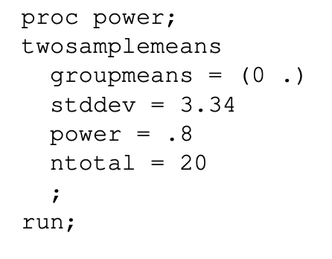
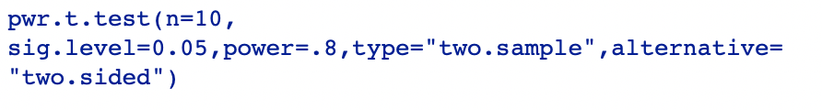
R and SAS do this a bit differently
Solving for effect size-so not as direct as SAS

Slide 70
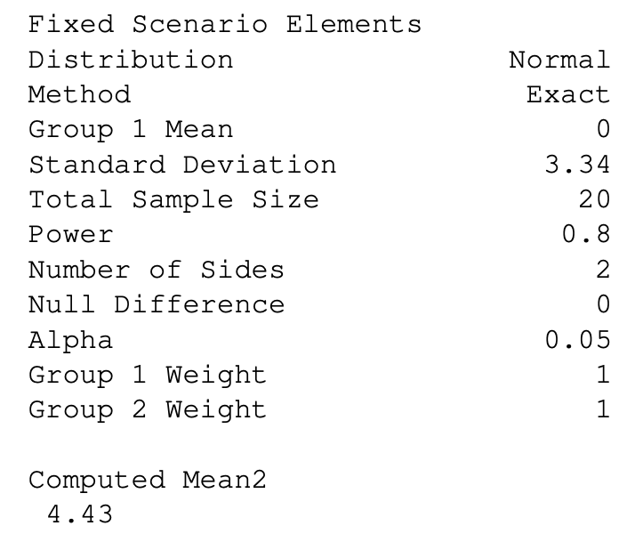
Output
In other words, the minimum detectable difference for this study is 4.4. If the true population means were this far apart, at a significance level of 0.05, the power would be 0.80. Hence, the researchers should not proceed with the study if they think the true difference is less than 4.4.

Slide 71
>2 independent means
A researcher is interested in investigating the effects of three different diets on percent weight loss when implemented along with a 5-day per week cardio exercise program. The diets include a low carbohydrate diet, a high protein diet, and a control diet (i.e., just exercise). The researcher would like to achieve power of 80%. The group means are believed to be 8, 10 and 6 lbs, respectively, and she assumes a common standard deviation of 3 lbs. If the researcher wants to test the overall hypothesis at a 0.05 level of significance, estimate the sample size.

Slide 72
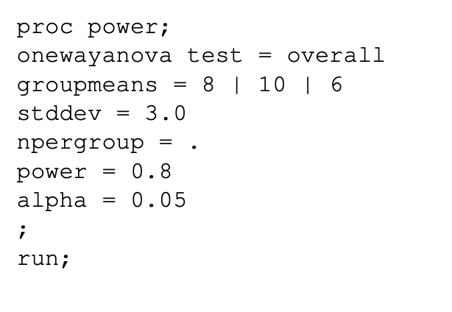
SAS code

Slide 73
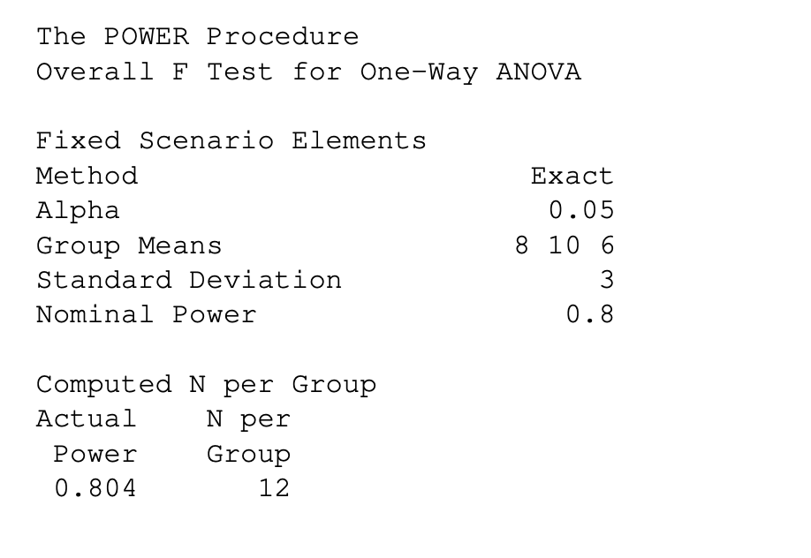
SAS output

Slide 74
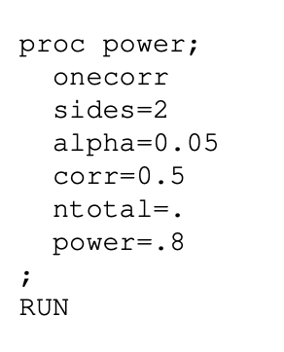

Predictor
A researcher is interested in seeing whether a significant positive correlation exists between reading speed and IQ in adolescents. Before beginning the study, the researcher would like to know what sample size would be required to detect a positive correlation of 0.5 with power of 80%.

Slide 75
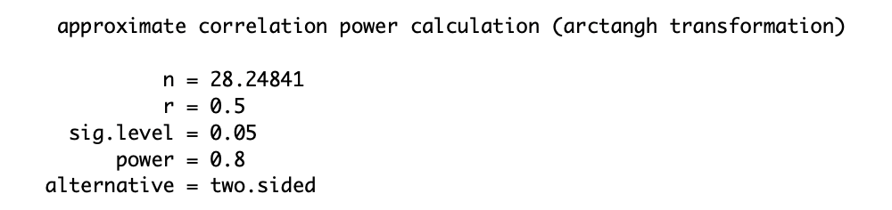
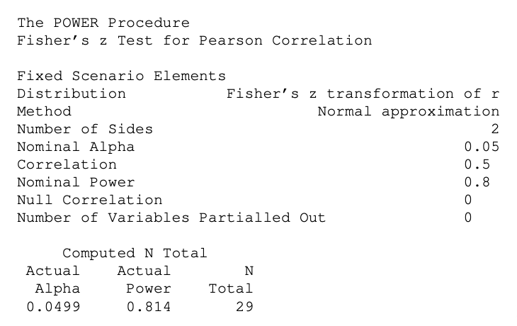
Output
If a smaller correlation is assumed, say 0.3, keeping everything else the same, will the required sample size be bigger or smaller than 29?

Slide 76
WHAT CAN GO WRONG?
Might have to increase number of patients because of overly optimistic guesses
Should not allow small differences in sample sizes to dictate scientific priorities
Need to compensate for loss to follow-up

Slide 77
POWER CALCULATIONS ARE APPROXIMATIONS
Equations are mathematical approximations
Equations depend on guesses about parameters
Power calculation should NOT be taken rigidly

Slide 78
FINAL WORD
In practice, these sample size formulae do not take into account patient factors that might influence prognosis.
Hence, these sample size estimates are usually conservative, given further adjustments for covariates.

Slide 79
Sample Size
Are there enough patients to answer the questions?
Negative results can be due to three reasons:
No difference
Sample size is too small
Confounding variables

Slide 80
Sample Size Calculations
Depends on the study design and the statistical test.
Outcome Variables: Continuous
Dichotomized (yes or no)

